Slide 1
Naledi Saul, Director
The First 90 Days
The Work
How to Establish Yourself in a New Position
…during
COVID
Winning!
90 days!
60 days!
30 days!
Notes:
The five scenarios that we’ve identified are:
So we’re going to talk about these situations. In talking through this situation, you’ll do some self assessment, developing learning goals, learning styles, work styles, the definitition of bullying, and pinpoint what I call a red flag moment – the moment when you should read out for support.
You all wouldn’t have made it this far if you weren’t already skillsful and savvy. What you’ll hopefully get is some confirmation that you’re handling difficult situations like these well wich is one of the reasons, while I went back and forth on this, I langded on the side that I’d like the faculty to be part of the conversation. You’ll also get, some frameworks and different lens which to look ah how to view, and respond and when you’re faced with these scenarios, which quite frankly, for a numbe rof reasons, aren’t always so cut and dry.
Finally, I’ll say that we re piloting this session, and are still figuring it out for your fellow students. And so any feedback, on length, topic, format, scenario, faculty involvement, whether or not you think this session oguht to exist at all or is not the best use of your valuable time, is greatly appreciated and will be seriously considered.
….okay? Let’s get started.

Slide 2
Your Boss
You
In the beginning, many of us are focused on the work –
- determining what we have to do
- learning the information and
- developing the skills to do it
because we believe that our work will speak for itself and solidify our reputation.
But it can help helpful to give equal, intentional consideration to 4 other factors...
The Work
Your Organization
Your Team
Why do the first 3-6 months matter in a new position?
People solidify a first impression pretty quickly - particularly a negative one. For example, “people require more evidence to perceive improvement in someone’s moral character than to perceive a decline.”*
3 months is halfway to the 6-month standard probation period (when it’s easier to fire you/easier for you to leave). Working less that 6 months? Think first 25% of experience.
* Nadav Klein, Ed O'Brien. The Tipping Point of Moral Change: When Do Good and Bad Acts Make Good and Bad Actors? Social Cognition, 2016; 34 (2): 149 DOI: 10.1521/soco.2016.34.2.149
The moral tipping point: Why it's hard to shake a bad impression. Swww.sciencedaily.com/releases/2016/07/160712142757.htm
© 2018 The Regents of the University of California. All rights reserved. Naledi.Saul@ucsf.edu. Please do not reprint without permission.
Notes:
The first 4th of your time period! – because internships are at 90 days.

Slide 3
Your Boss
You (Brand You)
You don’t have to do everything – just do your thing - Engaging with integrity helps when you are navigating new environments
The Work
Your Organization
Your Environment
Your Team
1
2
3
What do you value?
Honesty
Working as part of a team
Ambition/Drive
(Establish Your Rep.) What do you want to be known for?
Someone who tells the truth even when I think the person doesn’t want to hear it
A great colleague
Proactive, productive and self motivated
How will you demonstrate that?
When in 1:1 – consider what my boss needs to know, not just what they want to hear.
Note when I try to sugarcoat.
Learn people’s names.
Show interest in what they are working on.
Recognize achievement
Offer to help when I can.
Send weekly emails to my boss updating them on what I have done, am doing and my questions.
Always meet deadlines.
© 2018 The Regents of the University of California. All rights reserved. Naledi.Saul@ucsf.edu. Please do not reprint without permission.

Slide 4
Your Boss
You (Brand You)
What’s the
COVID
Factor?
The Work
Your Organization
bit.ly/GSICE2020first
YOUR TURN
Your Environment
Your Team
1
2
3
What do you value?
Honesty
Working as part of a team
Ambition/Drive
(Establish Your Rep.) What do you want to be known for?
Someone who tells the truth even when I think the person doesn’t want to hear it
A great colleague
Proactive, productive and self motivated
How will you demonstrate that?
When in 1:1 – consider what my boss needs to know, not just what they want to hear.
Note when I try to sugarcoat
Find out what the boss considers to be ‘high quality work’.
I tend to be sloppy – always grammar check my work.
Send weekly emails to my boss updating them on what I have done, am doing and my questions
Always meet deadlines.
© 2018 The Regents of the University of California. All rights reserved. Naledi.Saul@ucsf.edu. Please do not reprint without permission.

Slide 5
Your Boss
You
The Work
Your Organization
Your Environment
Your Team
© 2018 The Regents of the University of California. All rights reserved. Naledi.Saul@ucsf.edu. Please do not reprint without permission.
Notes:
Learning styles just got debunked.
But does scientific research really support the existence of different learning styles, or the hypothesis that people learn better when taught in a way that matches their own unique style?
Unfortunately, the answer is no, according to a major new report published this month in Psychological Science in the Public Interest, a journal of the Association for Psychological Science. The report, authored by a team of eminent researchers in the psychology of learning—Hal Pashler (University of San Diego), Mark McDaniel (Washington University in St. Louis), Doug Rohrer (University of South Florida), and Robert Bjork (University of California, Los Angeles)—reviews the existing literature on learning styles and finds that although numerous studies have purported to show the existence of different kinds of learners (such as “auditory learners” and “visual learners”), those studies have not used the type of randomized research designs that would make their findings credible.
But preferences live one. If you’re about to learn a new techniwuq, or a new computer software, or how to change a tire. You may be one of the people who has a strong pference.

Slide 6
Your Boss
You
The Work
Your Organization
Your Team
© 2018 The Regents of the University of California. All rights reserved. Naledi.Saul@ucsf.edu. Please do not reprint without permission.

Slide 7
Your Boss
7 Supervisory
Responsibilities
You
The Work
Set expectations/ Take baseline assessment
Set expectations/ Take baseline assessment
Set expectations/ Take baseline assessment
Set expectations/ Take baseline assessment
Set expectations/ Take baseline assessment
Your Organization
1
Set expectations/ Take baseline assessment
2
Delegate/teach/train effectively
Delegate/teach/train effectively
Delegate/teach/train effectively
Delegate/teach/train effectively
Delegate/teach/train effectively
Delegate/teach/train effectively
3
Give kudos and corrective feedback continuously
Your Team
4
Recognize & reward progress and achievement
5
Articulate & enforce
consequences
6
Manage conflict
7
Provide support
© 2018 The Regents of the University of California. All rights reserved. Naledi.Saul@ucsf.edu. Please do not reprint without permission.

Slide 8
Your Boss
7 Supervisory
Responsibilities
You
The Work
Set expectations/ Take baseline assessment
Set expectations/ Take baseline assessment
Set expectations/ Take baseline assessment
Set expectations/ Take baseline assessment
Set expectations/ Take baseline assessment
Your Organization
1
Set expectations/ Take baseline assessment
2
Delegate/teach/train effectively
Delegate/teach/train effectively
Delegate/teach/train effectively
Delegate/teach/train effectively
Delegate/teach/train effectively
Delegate/teach/train effectively
3
Give kudos and corrective feedback continuously
Your Team
In the first 3 months, your goal is to figure out 3 key things. How they:
Set expectations
Train
Give feedback
4
Recognize & reward progress and achievement
5
Articulate & enforce
consequences
What’s the
COVID
factor?
6
Manage conflict
7
Any disruption means you need to reassess their work style preferences and how to work together
Provide support
© 2018 The Regents of the University of California. All rights reserved. Naledi.Saul@ucsf.edu. Please do not reprint without permission.

Slide 9
Your Boss
You
The Work
Your Organization
Your Team
© 2018 The Regents of the University of California. All rights reserved. Naledi.Saul@ucsf.edu. Please do not reprint without permission.

Slide 10
Your Boss
You
The Work
Your Organization
Your Team
© 2018 The Regents of the University of California. All rights reserved. Naledi.Saul@ucsf.edu. Please do not reprint without permission.

Slide 11
Your Boss
You
Did you know there are three types of people?
The Work
Your Organization
Your Team
© 2018 The Regents of the University of California. All rights reserved. Naledi.Saul@ucsf.edu. Please do not reprint without permission.

Slide 12
What’s the
COVID
Factor?
Did you know there are three types of people?
More people will be here. This can affect your morale. Your productivity.
Observe
1. Who will be your allies?
2. Who will you need to intentionally limit your time with?
bit.ly/GSICE2020second
ENGAGED
employees work with passion and feel a profound connection to their organization. They drive innovation and move the organization forward
NOT-ENGAGED
employees are essentially ‘checked out’. They’re sleepwalking through their workday, putting time, but not energy or passion into their work
ACTIVELY DISENGAGED employees aren’t just unhappy at work; they’re busy acting out their unhappiness. Every day, these workers undermine what their engaged coworkers accomplish.
Gallup State of the American Worker Survey
Notes:
Take a moment – think back to an employment opportunity. How would you categorize people. What did that look like?

Slide 13
Your Boss
You
The Work
Your Organization
Your Team
© 2018 The Regents of the University of California. All rights reserved. Naledi.Saul@ucsf.edu. Please do not reprint without permission.

Slide 14
Your Boss
You
The Work
Your Organization
Your Team
© 2018 The Regents of the University of California. All rights reserved. Naledi.Saul@ucsf.edu. Please do not reprint without permission.

Slide 15
Your Boss
Do you feel you can do your best work? If not, why not?
(e.g.: is it the organizational values? The relationships? Do you have what you need to do what is expected of you?)
You
The Work
Your Organization
Frederic Herzberg
Theory of Motivation 1968
Abraham Maslow’s
Hierarchy of Needs (1943)
Sense of personal achievement
Advancement
Growth
Responsibility
Stimulating work
Self Esteem
Safety
Physiological
Belonging/
Social Needs
Self
Actualization
Achieving one’s potential, being creative, serving a cause, contributing to society
Your Team
Self-Control (autonomy)
Status
Recognition
Prestige, self-respect, competence, self confidence, sense of self worth
Professional Relationships,
Supervision
Friends, affiliation, affection, relationships, love
Work environment
Org. policies
Both physical (security, shelter, protection, law and order, health insurance, pension plans, secure job) and psychological freedom from fear and anxiety
Job security
Salary/benefits
Basic survival needs such as food and water
© 2018 The Regents of the University of California. All rights reserved. Naledi.Saul@ucsf.edu. Please do not reprint without permission.

Slide 16
Your Boss
Do you feel you can do your best work? If not, why not?
(e.g.: is it the organizational values? The relationships? Do you have what you need to do what is expected of you?)
You
The Work
Your Organization
Frederic Herzberg
Theory of Motivation 1968
Abraham Maslow’s
Hierarchy of Needs (1943)
Sense of personal achievement
Advancement
Growth
Responsibility
Stimulating work
Self Esteem
Safety
Physiological
Belonging/
Social Needs
Self
Actualization
Achieving one’s potential, being creative, serving a cause, contributing to society
Your Team
Self-Control (autonomy)
Status
Recognition
Prestige, self-respect, competence, self confidence, sense of self worth
Professional Relationships,
Supervision
Friends, affiliation, affection, relationships, love
Work environment
Org. policies
Both physical (security, shelter, protection, law and order, health insurance, pension plans, secure job) and psychological freedom from fear and anxiety
Job security
Salary/benefits
Basic survival needs such as food and water
© 2018 The Regents of the University of California. All rights reserved. Naledi.Saul@ucsf.edu. Please do not reprint without permission.

Slide 17
Your Boss
Do you feel you can do your best work? If not, why not?
(e.g.: is it the organizational values? The relationships? Do you have what you need to do what is expected of you?)
You
The Work
Your Organization
Frederic Herzberg
Theory of Motivation 1968
Abraham Maslow’s
Hierarchy of Needs (1943)
Sense of personal achievement
Advancement
Growth
Responsibility
Stimulating work
Self Esteem
Safety
Physiological
Belonging/
Social Needs
Self
Actualization
Achieving one’s potential, being creative, serving a cause, contributing to society
Your Team
Self-Control (autonomy)
Status
Recognition
Prestige, self-respect, competence, self confidence, sense of self worth
Professional Relationships,
Supervision
Friends, affiliation, affection, relationships, love
Work environment
Org. policies
Both physical (security, shelter, protection, law and order, health insurance, pension plans, secure job) and psychological freedom from fear and anxiety
Job security
Salary/benefits
Basic survival needs such as feed and water
© 2018 The Regents of the University of California. All rights reserved. Naledi.Saul@ucsf.edu. Please do not reprint without permission.

Slide 18
Do you feel you can do your best work? If not, why not?
(e.g.: is it the organizational values? The relationships? Do you have what you need to do what is expected of you?)
What’s the
COVID
Factor?
Frederic Herzberg
Theory of Motivation 1968
Abraham Maslow’s
Hierarchy of Needs (1943)
Sense of personal achievement
Advancement
Growth
Responsibility
Stimulating work
Self Esteem
Safety
Physiological
Belonging/
Social Needs
Self
Actualization
Achieving one’s potential, being creative, serving a cause, contributing to society
Self-Control (autonomy)
Status
Recognition
Prestige, self-respect, competence, self confidence, sense of self worth
Professional Relationships,
Supervision
Friends, affiliation, affection, relationships, love
Work environment
Org. policies
Both physical (security, shelter, protection, law and order, health insurance, pension plans, secure job) and psychological freedom from fear and anxiety
Job security
Salary/benefits
Basic survival needs such as food and water
© 2018 The Regents of the University of California. All rights reserved. Naledi.Saul@ucsf.edu. Please do not reprint without permission.

Slide 19
That’s a lot of information. What does it look like when it – and you - are working?
© 2018 The Regents of the University of California. All rights reserved. Naledi.Saul@ucsf.edu. Please do not reprint without permission.

Slide 20
Your specific values, your approach, your strengths & your work style are recognized and rewarded
Who Are You: Articulate your values, Define your reputation, and consider the ways you can live those values at work
Assess Everything, and take stock at 3 months
Your Boss
You
How do they set expectations
How do they teach/train
How to they give kudos and corrective feedback
The Goal: to understand how they function and secure an early win
Do you feel you can do your best work? If not, why not? (e.g.: is it the organizational values? The policies? Do you have what you need to do what is expected of you? Etc.)
The Work
Your Organization
Who is engaged? Not engaged? Actively disengaged?
Do they take pride or pleasure in their work?
How to they interact with each other? How are they interacting with you?
Who are your mentors/allies? Who is not and why?
Your Team
The greater the misalignment or gap between you and your boss, team, organization and/or work, the more proactive you will need to be around
Self-care,
work-arounds and
managing up
© 2018 The Regents of the University of California. All rights reserved. Naledi.Saul@ucsf.edu. Please do not reprint without permission.

Slide 21
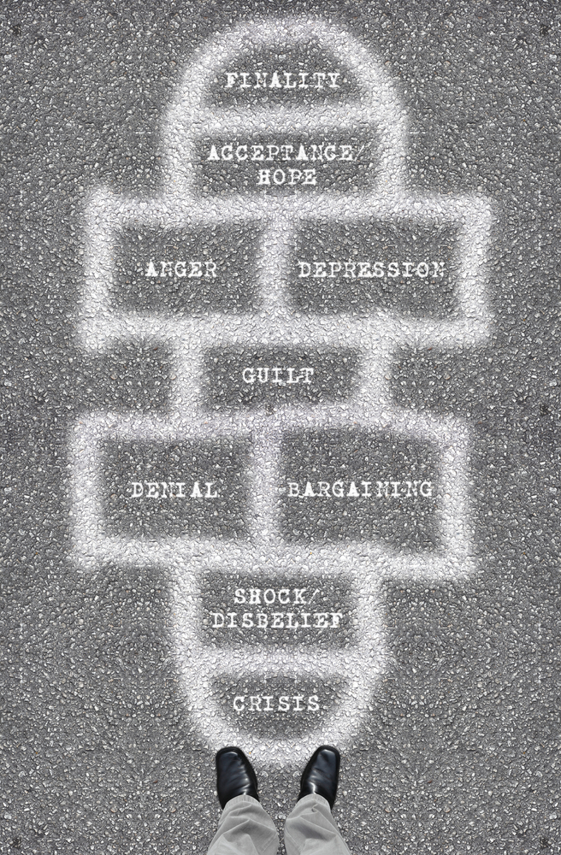
IF YOU GET IT WRONG
Depending on how much you wanted it to work out and how you feel about your options, your brain might be inclined to try to minimize things or
blow them out of proportion.
DON’T OVERCORRECT: You’re still in the first quarter of your internship! Reach out and we’ll strategize how to turn things around!
© 2018 The Regents of the University of California. All rights reserved. Naledi.Saul@ucsf.edu. Please do not reprint without permission.

Slide 22
Naledi Saul, Director
Your Boss
The First 90 Days
You
The Work
Your Organization
How to Establish Yourself in a New Position
Your Team
…during
COVID
Winning!
90 days!
60 days!
30 days!
Notes:
The five scenarios that we’ve identified are:
So we’re going to talk about these situations. In talking through this situation, you’ll do some self assessment, developing learning goals, learning styles, work styles, the definitition of bullying, and pinpoint what I call a red flag moment – the moment when you should read out for support.
You all wouldn’t have made it this far if you weren’t already skillsful and savvy. What you’ll hopefully get is some confirmation that you’re handling difficult situations like these well wich is one of the reasons, while I went back and forth on this, I langded on the side that I’d like the faculty to be part of the conversation. You’ll also get, some frameworks and different lens which to look ah how to view, and respond and when you’re faced with these scenarios, which quite frankly, for a numbe rof reasons, aren’t always so cut and dry.
Finally, I’ll say that we re piloting this session, and are still figuring it out for your fellow students. And so any feedback, on length, topic, format, scenario, faculty involvement, whether or not you think this session oguht to exist at all or is not the best use of your valuable time, is greatly appreciated and will be seriously considered.
….okay? Let’s get started.

Slide 23
 |  | Opening
 |  | You
8 | EXERCISE | YOU Write values/examples
3 | EXERCISE | YOU Write one more suggestion
3 | EXERCISE | Types – internal/external consider, consider covid
3 | EXERCISE | Types – systematic/structured or associative consider, consider covid
8 | EXERCISE | BOSS: How did you come to understand expectations? How do/did you experience kudos/corrective feedback? How has COVID affected your boss? For example: Pre/post COVID, do you meet less frequently? Are they less organized? Are they more stressed?
8 | EXERCISE | TEAM- Take a moment – think back to an employment opportunity. How would you categorize people. What did that look like?

Slide 24
Your Boss
You
Things to ask about and observe
The Work
…during
COVID?
How does your boss...
Presentation
Want you to present yourself (dress, etc.)
Want you to behave?
Communcation
Want you to communicate?
Want you to communicate bad news?
Performance
Define your performance benchmarks?
Evaluate staff?
Recognize and reward?
Let you know what they don’t want you to do?
Experience satisfaction or joy at work?
Succeed? Fail?
Your Organization
Your Team
Figure out how to work together
Define expectations
Agree on a diagnosis of the situation you were brought in to solve
Negotiate for resources
Secure an early win
© 2018 The Regents of the University of California. All rights reserved. Naledi.Saul@ucsf.edu. Please do not reprint without permission.

Slide 25
15
15
10 (3&4)

